Slide 1
Securing Your Applications and Web Services with the Geneva Framework
Jim Lavin

Slide 2
About Me
Technical Lead with the Transportation Industry Consulting Services Group of EDS, an HP Company
Programming since 1978 – Assembly Language on a HeathKit H8 computer
Worked mostly on Mid-Range, Desktop and Hand-Held Systems
Polyglot Programmer – Assembly, Basic, C, C++, Pascal, Fortran, C#, XML, XSLT, XAML, HTML, CSS, JavaScript and Java
Allergic to Big Metal, PL/1, Cobol and IMS

Slide 3
Agenda
Challenges in a Connected World
Claims-Based Identity Concepts
Building a simple Passive Security Token Service
Securing your ASP.NET Web Application
Building a simple Active Security Token Service
Securing your WCF Web Services
Using Delegation to access secured Web Services

Slide 4
Challenges In Identity
Identity is essential, but not straightforward
Lots of technologies and standards
Complex decision tree, technology to scenario
Cloud computing adds new requirements
Federated single sign on is a must
Usually can’t read enterprise directory
Need a new approach
Simplify programming model
Cloud/on-premises agnostic

Slide 5
Challenge: Getting Information About the User
Many authentication systems only convey an identifier, not user attributes
Applications must do lookups in directories, databases for information about user
Location of info not obvious – every organization’s information system is slightly different
Not straightforward how to look up information about a user from another organization
Applications residing in cloud may not be able to read enterprise directory

Slide 6
Challenge: Federation
Federation is essential for business to business applications, and when using cloud services
Organizations don’t want to manage separate user accounts at every cloud service or partner
Want end users to have single sign on experience

Slide 7
Challenge: Identity Delegation
Front end application wants to call back end service, “Acting As” logged in user
Today’s approaches
Gather user’s credentials at front end – gives front end app too much power
Give front end full privileged to back end, “Trusted subsystem” – takes control out of hands of back end app
Kerberos constrained delegation – only works with Kerberos

Slide 8
Claims-Based Access Model
Claim
Statement by one party about other party
May be an identifier, a characteristic
Security token
Signed document containing claims
Produced by Security Token Service (STS)
Identity Metasystem
Protocols and architecture for exchange claims
Claims-aware application
Claims delivered when user accesses app

Slide 9
Claims-Based Access Model
Security Token Service
trust
3. Read policy
Establish relationship using metadata
4. Get claims
End User
Application Server
2. Read policy
5. Send claims

Slide 10
Role Of Security Token Services
Key to flexibility in model: Externalize authentication to an STS
STS takes care of
How to authenticate user
Where to source claim values about user
Emitting specific types, formats and values of claims to satisfy a specific application
Active and Passive STS
Passive STS used by clients that do not have capability to interact with the STS directly; HTML, ASP.NET
Active STS used mainly by smart clients; WinForm, WPF, WCF, etc.
Allows application logic to be driven by claims
Notes:
Smart clients are referred to as “active” because they have plumbing (WCF, for example) that can parse policy and implement WS-Trust directly. Web browsers are referred to as “passive” because they can’t typically be modified to do these things directly, so cookies, redirection, and JavaScript are used mimic the WS-Trust protocol in a browser-friendly way.

Slide 11
Building a Passive STS
Steps
Create an implementation class derived from SecurityTokenService
Create an implementation class derived from SecurityTokenServiceConfiguration
Add a FederatedPassiveTokenService server object to the default.aspx
Configure authentication method

Slide 12
Building a Passive STS
Demo

Slide 13
Securing an ASP.NET Application
Steps
Add Assemblies and HTTP Modules to web.config
Switch to anonymous authentication
Create metadata to establish trust
Turn on Passive Redirection
User redirected, authenticated, returns claims
Benefit
No code change: works with .Net role-based security
Flexibility: STS admin decides how to authenticate user and retrieve role data

Slide 14
Getting Information About User
Steps
Write code to read claims using IClaimsPrincipal, IClaimsIdentity
Benefits
Easy to get user information
No directory lookup necessary in application
STS admin decides where to get information about user

Slide 15
Securing an ASP.NET Application
Demo

Slide 16
Securing an WCF Service
Steps
Add Assemblies to project
Implement a class derived form ServiceHostFactory
Implement a class derived from IssuerNameRegistry
Implement a class derived from IdentityModelServiceAuthorizationManager
Create metadata to establish trust
Modify the .SVC to use the ServiceHostFactory
Modify the binding to use WS-Federation
Benefit
Little code change, mostly hosting plumbing
Allows you to access Claims information via Thread.CurrentPrincipal

Slide 17
Securing a WCF Service
Demo

Slide 18
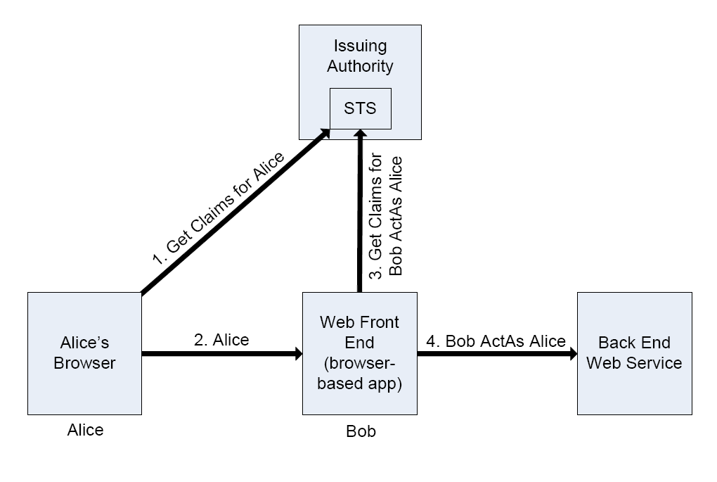
Calling a WCF Service using Identity Delegation

Slide 19
Calling a WCF Service using Identity Delegation
Steps
Configure delegation policy on STS
Write WCF code to call back end service using ActAs client credential
Benefits
Familiar WCF programming model
Fine grained control over delegation policy
Back end gets claims it needs
Back end can audit user access accurately
App can turn claims back into mapped NT user for access to Kerberos-protected resources

Slide 20
Calling a WCF Service using Identity Delegation
Demo

Slide 21
"Geneva" Schedule
Beta 1
October 2008
Beta 2
1st Half 2009
RTM
2nd Half 2009

Slide 22
Review
Challenges in a Connected World
Claims-Based Identity Concepts
Building a simple Passive Security Token Service
Securing your ASP.NET Web Application
Building a simple Active Security Token Service
Securing your WCF Web Services
Using Delegation to access secured Web Services

Slide 23
PDC Presentations About Identity
http://channel9.msdn.com/pdc2008
PDC Tag: Identity
Software
(BB42) Identity: "Geneva" Server and Framework Overview
(BB43) Identity: "Geneva" Deep Dive
(BB44) Identity: Windows CardSpace "Geneva" Under the Hood
Services
(BB22) Identity: Live Identity Services Drilldown
(BB29) Identity: Connecting Active Directory to Microsoft Services
(BB28) .NET Services: Access Control Service Drilldown
(BB55) .NET Services: Access Control In the Cloud Services

Slide 24
Contact Info
Email: jlavin@jimlavin.net
Blog: http://www.jimlavin.net/blog
Twitter: http://twitter.com/jimlavin

